Slide 1
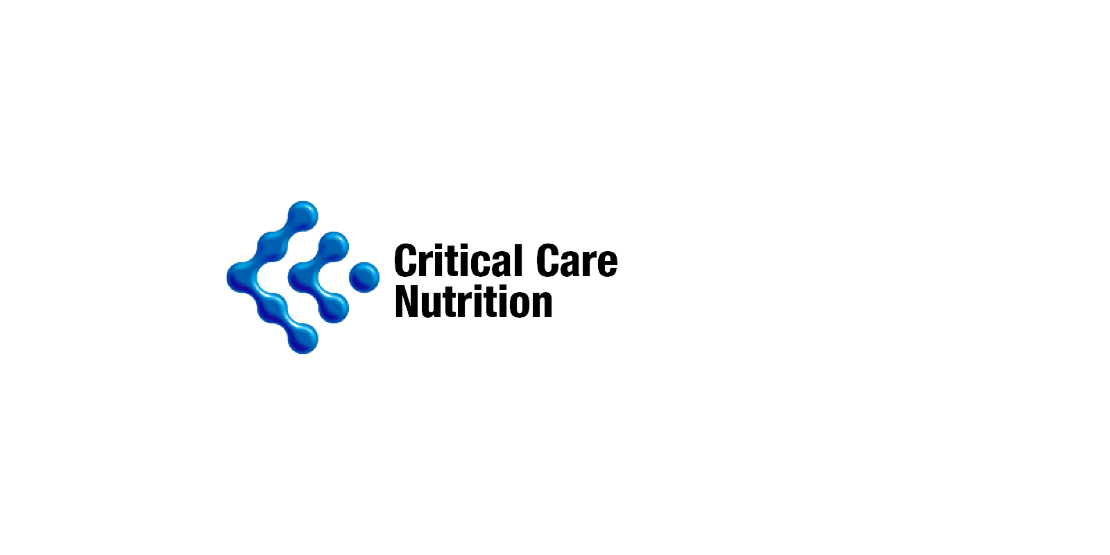


Strategies to Optimize
Enteral Nutrition Therapy
Daren K Heyland
Professor of Medicine
Queen’s University, Kingston General Hospital
Kingston, ON Canada

Slide 2

Disclosures
Principal Investigator and Consultant in academic-industry partnered trials sponsored by GlaxoSmithKline, Lyric Pharmaceuticals, Cardinal Health, and E-motion Medical

Slide 3

Q
What do we mean by
‘optimal nutrition?’
A
Patients receiving at least 80% of their prescription
￼

Slide 4
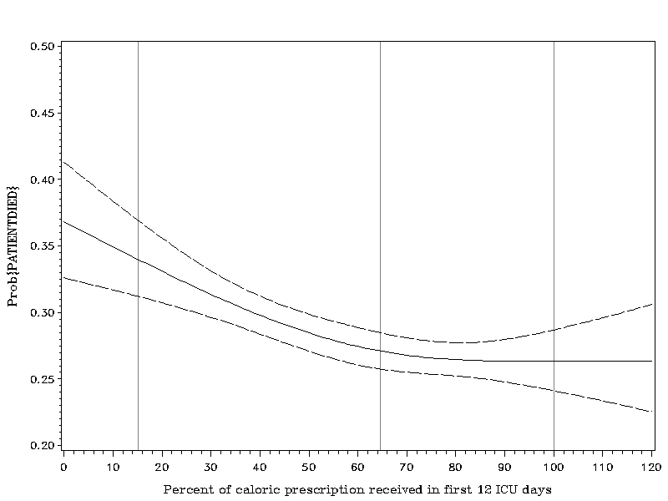
Association Between 12-day Nutritional
Adequacy and 60-Day Hospital Mortality
Optimal amount=
80-85%
Probability of Death
Heyland CCM 2011

Slide 5
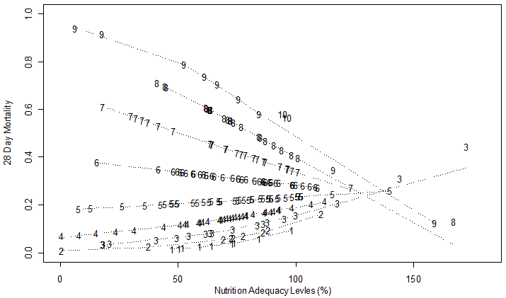
High Nutrition Risk Patients Benefit
from More EN Whereas Low Risk Do Not
Interaction Between NUTRIC Score and Nutritional Adequacy (n = 211)*
Heyland DK, et al. Crit Care. 2011;15(6):R268.

Slide 6

The Validation of the NUTrition Risk in the Critically Ill Score
(NUTRIC Score)
Validated in 3 separate databases including the INS Dataset involving over 200 ICU’s worldwide ^{1,2,3}
Validated without IL-6 levels (modified NUTRIC) ²
Independently validated in Dutch, Brazilian, Portuguese, and Asian populations ^{4,5,6,7}
Predictive validity superior than MUST (malnutrition assessment)⁷
Not validated in post hoc analysis of the PERMIT trial ⁸
– RCT of different caloric intake (protein more important)
– Underpowered, very wide confidence intervals
Discriminates patients who benefit the most in post hoc analysis of TOP uP trial
Heyland Critical Care 2011, 15:R28
Rahman, Clinical Nutrition 2013.
Compher, CCM, 2016
Rosa Clinical Nutrition ESPEN 2016
Mendes J Crit Care 2017
Mukhopadhyah Clinical Nutrition 2016
De Vries Eur J Clin Nutr 2017
Arabi AmJRCCM 2016
Wischmeyer Crit Care 2017

Slide 7
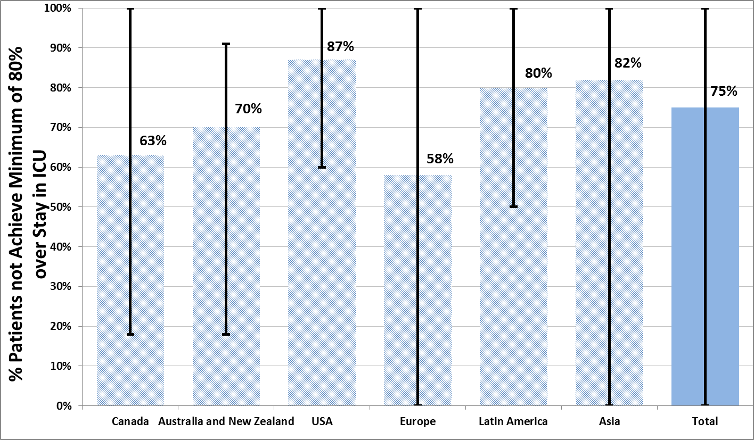
The Prevalence of Iatrogenic Underfeeding
in the Nutritionally ‘At-Risk’ Critically Ill Patient
% high risk patients who failed to meet minimal quality targets (80% overall energy adequacy)
Of all at-risk patients, 14% were ever prescribed volume-based feeds 15% ever received sPN
Heyland
Clinical Nutrition 2015
7

Slide 8
Results of 2014 INS (186 sites worldwide and approx. 4000 patients)
We Don’t Discriminate High from Low-risk Patients!
In all comers:
• At a patient level, 16% of patients averaged more than 80% protein adequacy
• At a site level, 6% (11 sites) averaged more than 80% in all patients
In High NUTRIC patients:
• 16% of high NUTRIC Score patients received more than 80% of prescribed amount
• 7% (16 sites) managed to provide more than 80% of prescribed amounts to high-risk patients
Performance in ‘all’ patients same as High NUTRIC patients
Heyland NCP 2017

Slide 9
A Multi-Pronged Approach:
Strategies for Combating Iatrogenic Underfeeding
*PROBLEMS
Early Intervention
Innovate advanced placement technologies
Admission order sets
*Delayed Feeding
Optimal Delivery
Second generation feeding protocols
Smart Pump Solutions
Integrated Nutrition Monitoring Platform (INFORM)
Therapeutic interventions to prevent and treat ‘dysmotility’
*Inadequate Nutrition
Sustained Nutrition
Provide technology and educational solutions
across the care continuum to promote sustained
nutrition therapy (OPTICS)
*Fragmented
Care
Notes:
Notes to self: General talk track thoughts for our 3 pillars. Delayed Feeding - we know that patients are at increased nutritional risk if they are not fed within 48 hours and early intervention is imperative. Early placement sooner and safely assists with that (ie our IRIS technology). Inadequate Nutrition – there is strong evidence to show patients, especially the critically ill patients, actually receive less than 50% of their nutritional prescription (ie could tie in lack of formula / hydration with our feed / flush pump and pull in your PepUP protocol, INFORM and NUTRIC Score info). Fragmented Care – addresses the transition of patient care after d/c to avoid readmissions related to tube complications, dehydration etc. Tie in OPTICS (Family capacitation strategy) as well as our Kangaroo Wireless Connect Pump for sustained nutrition targeted for home care patients.

Slide 10
Timing of Enteral Nutrition
*site report from South American site from INS 2014

Slide 11
Q
Q
Why is nutrition delayed so often?
Why is nutrition delayed so often in the USA?
A
Difficulties and delays with placement
Poor system design
Devaluation of nutrition
Other reasons?
OPTICS

Slide 12
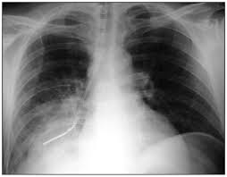
TUBE MISPLACEMENTS
THE PROBLEM
2 to 4% of feeding tubes are misplaced into the respiratory tract.¹
THE IMPACT
Blind feeding tube placement increases the risk for²:
Perforations
Pneumothorax
Aspiration pneumonia
1 death every 3 months in a major tertiary hospital.⁵
Roberts S. NCP 2007
Nascimento JPEN 2007

Slide 13
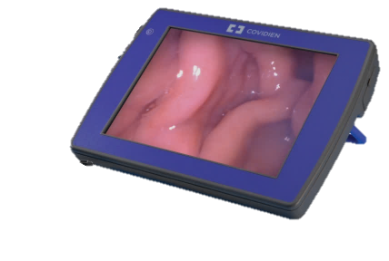

KANGAROO™ FEEDING TUBE WITH IRIS TECHNOLOGY
OUR SOLUTION
IRIS – Integrated Real-Time Imaging System
First Feeding Tube with Integrated Camera to Enable Visualization During Placement
3mm camera with LED illumination integrated into the distal tip
Real-time live video during placement
*Simulated image used to approximate final results

Slide 14
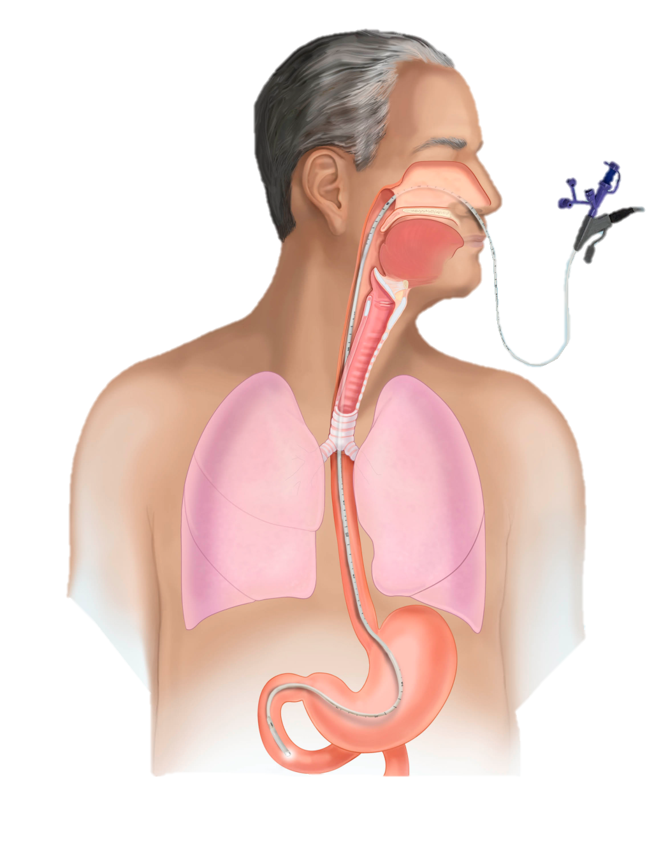
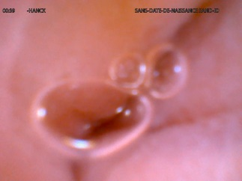
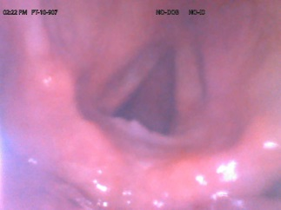
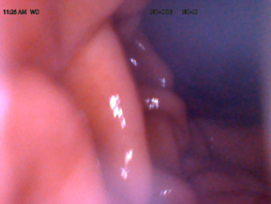
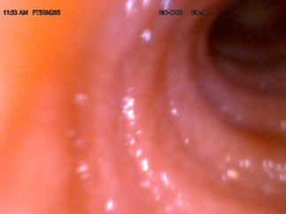
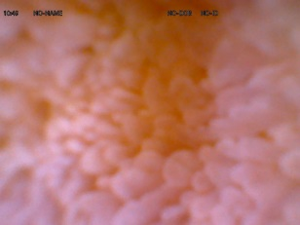
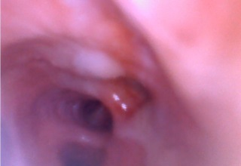
KANGAROO™ FEEDING TUBE WITH IRIS TECHNOLOGY
Anatomical markers
GI Tract
Respiratory Tract
Esophagus
Vocal Cords
Stomach Folds
Trachea
Duodenal Villi
Bronchial Split

Slide 15
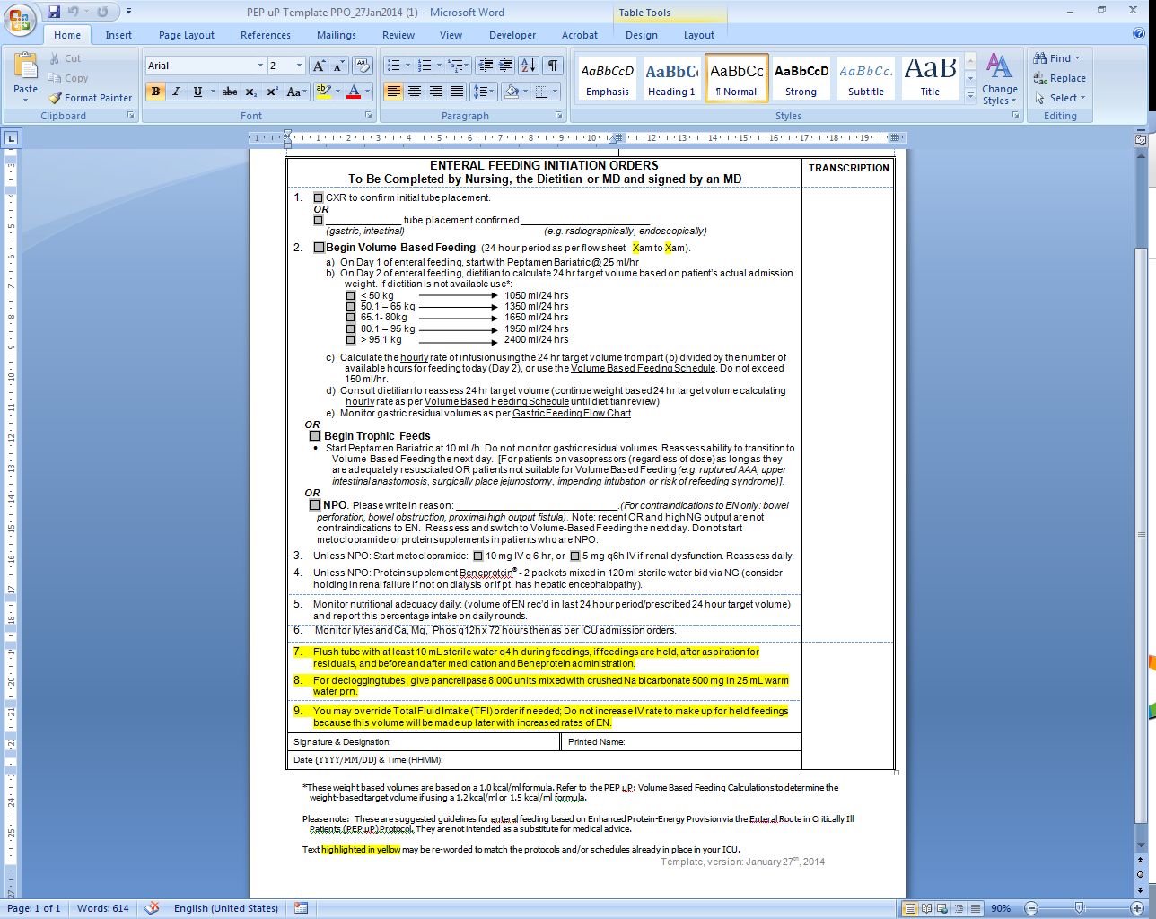
Pre-printed orders or “Automatic” Computer Order Entry for Starting EN
Dietitian Consult FOLLOWS,
not precedes initiation of nutrition
www.criticalcarenutrition.com
PepUp Enteral Feeding Initiation Order form found under Study Tools

Slide 16
A Multi-Pronged Approach:
Strategies for Combating Iatrogenic Underfeeeding
*PROBLEMS
Early Intervention
Innovate advanced placement technologies
Admission order sets
*Delayed Feeding
Optimal Delivery
Second generation feeding protocols
Smart Pump Solutions
Integrated Nutrition Monitoring Platform (INFORM)
Therapeutic interventions to prevent and treat ‘dysmotility’
*Inadequate Nutrition
Sustained Nutrition
Provide technology and educational solutions
across the care continuum to promote sustained
nutrition therapy (OPTICS)
*Fragmented
Care
Notes:
Notes to self: General talk track thoughts for our 3 pillars. Delayed Feeding - we know that patients are at increased nutritional risk if they are not fed within 48 hours and early intervention is imperative. Early placement sooner and safely assists with that (ie our IRIS technology). Inadequate Nutrition – there is strong evidence to show patients, especially the critically ill patients, actually receive less than 50% of their nutritional prescription (ie could tie in lack of formula / hydration with our feed / flush pump and pull in your PepUP protocol, INFORM and NUTRIC Score info). Fragmented Care – addresses the transition of patient care after d/c to avoid readmissions related to tube complications, dehydration etc. Tie in OPTICS (Family capacitation strategy) as well as our Kangaroo Wireless Connect Pump for sustained nutrition targeted for home care patients.

Slide 17
Reasons for Iatrogenic Underfeeding
Slow starts and slow ramp ups
Interruptions
  Tubes clogging or become dislodged
  Mostly related to procedures
Can be overcome by better feeding protocols (eg. PEP uP) and flushing
Impaired motility/GI Dysfunction
New therapeutic strategies!

Slide 18
Clinical Challenge: Clogged Feeding Tubes
ETIOLOGY₍₁₎
Lack of water flushes
Flushing agents used
Flushing methods used
Composition of feeding formula
Infusion rates
Medication-medication or medication-formula interactions
Formula contamination
SMALL BORE TUBES MAY BECOME CLOGGED IN UP TO 35% OF PATIENTS₍₂₎
Boullata JI, Carrera AL, Harvey L, et al. ASPEN safe practices for enteral nutrition therapy. JPEN J Parenter Enteral Nutr. 2017;41(1):15-103.
Marcuard SP, Stegall KS. Unclogging feeding tubes with pancreatic enzyme. JPEN J Parenter Enteral Nutr. 1990;14(2):198-200.

Slide 19
Clinical Challenge: Clogged Feeding Tubes
CONSEQUENCES ₍₁₎
Nutritional + Hydration Deficiencies
Hospital Readmission
Increased Cost
Increased Nursing Time & Intervention
Missed or Delayed Medication
Patient Risk
ASPEN RECOMMENDATIONS ₍₁₎
Flush 30 mL every 4 hours
Flushing with 30 mL after GRV checks
Flush before and after medication administration
Consider use of an automatic flush pump to prevent tube clogging
Boullata JI, Carrera AL, Harvey L, et al. ASPEN safe practices for enteral nutrition therapy. JPEN J Parenter Enteral Nutr. 2017;41(1):15-103.

Slide 20
Automated Feed/Flush Technology ➔ A Solution?
ICU¹
Flush Now: The use of technology to prevent occlusions in jejunal feeding tubes – a pilot evaluation
Automatic pump delivery of enteral water flushes and hydration eliminated jejunal tube occlusions on a hospital ward
The use of technology to deliver water flush orders may reduce nursing time and improve nursing efficiency
ICU & General Care Floor²
Attainment of enteral nutrition water flush orders using manual syringe versus automated pump delivery
The majority of enteral fed patients in both settings did not receive their full prescription for water flushes when manually delivered
The use of an automated feed and flush pump in conjunction with an education and awareness program resulted in a 46.7% improvement in delivery of ordered water flushes
Nadeau B, Weissbrod R, Trierweiler-Hauke B. Flush Now: The use of technology to prevent occlusions in jejunal feeding tubes – a pilot evaluation. Poster presented at ESPEN Congress; Sep 2017; The Hague, The Netherlands.
Nadeau B, Pash E, Parikh N. Attainment of enteral nutrition water flush orders using manual syringe versus automated pump delivery. Poster presented at: ASPEN’s CNW; Jan 2016; Austin, TX.
Notes:
In these small industry driven pilot studies:
Automatic feed/flush pump delivery of enteral water eliminated jejunal feeding tube clogs. This may reduce nursing time & improve nursing efficiency.
The use of automated feed/flush technology, in conjunction with an education and awareness program, has been demonstrated to be a statistically significant method that may help assure the delivery of water flushes.

Slide 21

Example of Use of Nurse-Directed Feeding Protocol
Start feeds at 25 ml/h
“50% of protein/calorie debt is due to low start point and slow ramp ups.”
> 250 ml
hold feeds
add motility agent
reassess q 4 h
< 250 ml
⬆ rate by 25 ml
reassess q 4h
Check Residuals q4h
Dijkink NCP 2016;31:86

Slide 22
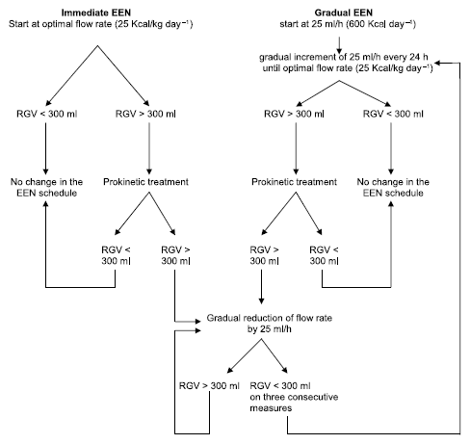
Initial Efficacy and Tolerability of Early EN with
Immediate or Gradual Introduction in Intubated Patients
This study randomized
100 mechanically ventilated patients (not in shock) to immediate goal rate vs.
gradual ramp up
(our usual standard).
The immediate goal group
received more calories with
no increase in complications.
Desachy A, et al. Intensive Care Med. 2008;34(6):1054-9.

Slide 23
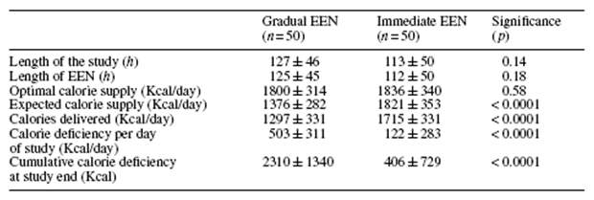
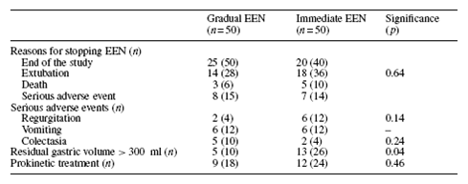
Initial Efficacy and Tolerability of Early EN with
Immediate or Gradual Introduction in Intubated Patients
Desachy A, et al. Intensive Care Med. 2008;34(6):1054-9.

Slide 24
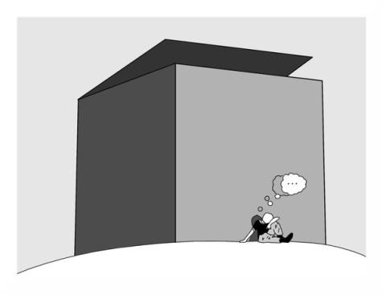
Can we do better?
The same thinking that got you into this mess won’t get you out of it!

Slide 25

The PEP uP Protocol!
The Efficacy of Enhanced Protein-Energy Provision via
the Enteral Route in Critically Ill Patients:
Different feeding options based on hemodynamic stability and suitability for high volume intragastric feeds.
In select patients, we start the EN immediately at goal rate, not at 25 ml/hr.
We target a 24 hour volume of EN rather than an hourly rate and provide the nurse with the latitude to increase the hourly rate to make up the 24 hour volume.
Start with a semi elemental solution, progress to polymeric
Motility agents and protein supplements are started immediately, rather than started when there is a problem.
Tolerate higher GRV threshold (300 ml or more)
A Major Paradigm Shift in How we Feed Enterally
Heyland Crit Care 2010;
see www.criticalcarenutrition.com for more information on the PEP uP tools

Slide 26

What is volume based feeding?
Based on a 24 hour volume total rather than an hourly rate
Initial infusion rate is determined by dividing the total by 24
Hourly rate may be changed during the day due to interruptions (i.e. tests, surgery)
to achieve the 24 hour volume total
During daily rounds, nursing report will include the percentage of feeds the patient received the previous day
DESIRED GOAL➔ to improve nutrition in ICU patients!
www.criticalcarenutrition.com
Volume Based Feeding schedule found under PepUp Study Tools

Slide 27
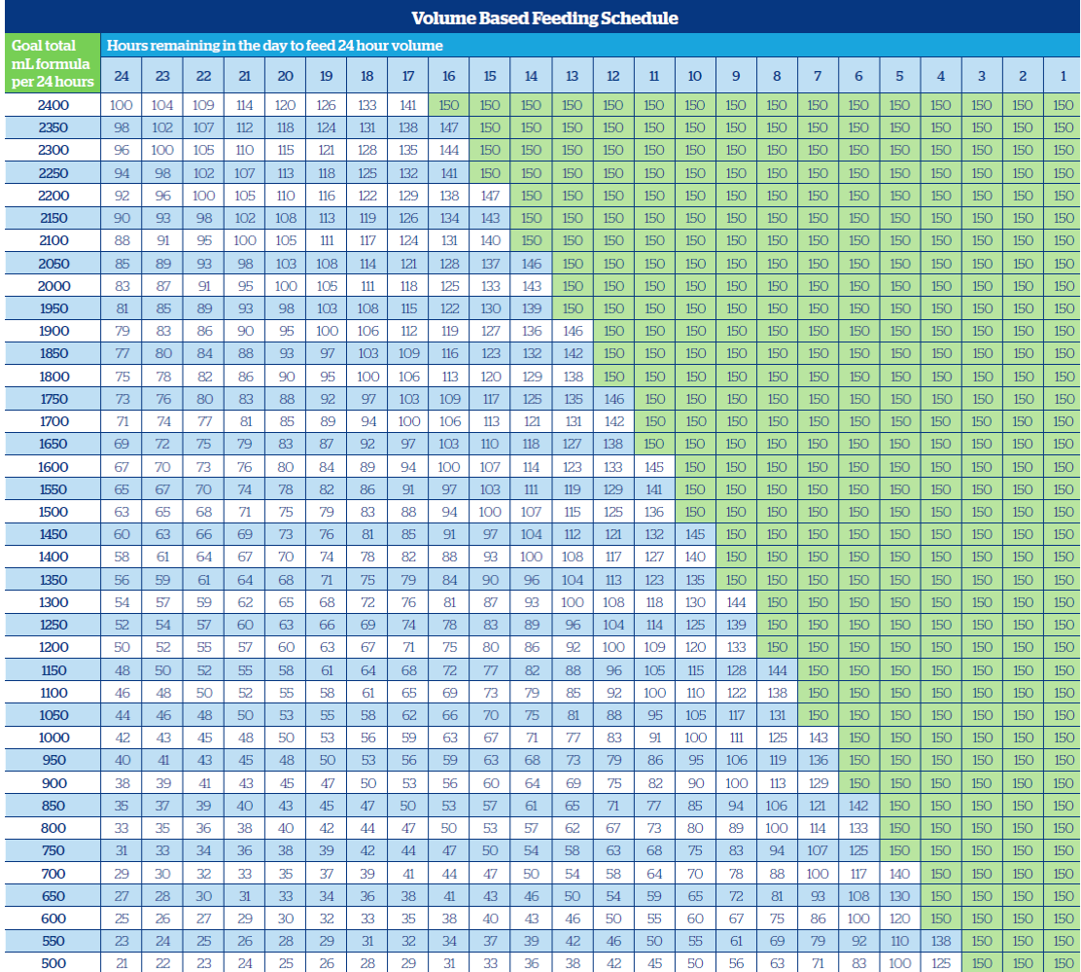
Volume-based Feeding Schedule
How much left to give
How much time left in day
www.criticalcarenutrition.com
This schedule can be found under the Volume Based Feeding Calculations under PepUp Study Tools

Slide 28
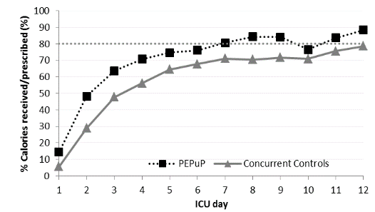
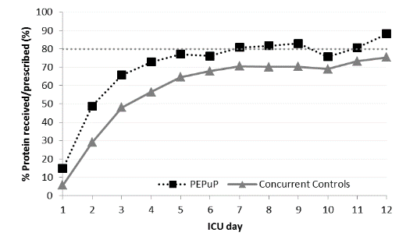
Results of the Canadian PEP uP Collaborative
Results of 2013 International Nutrition Survey
Heyland JPEN 2014

Slide 29
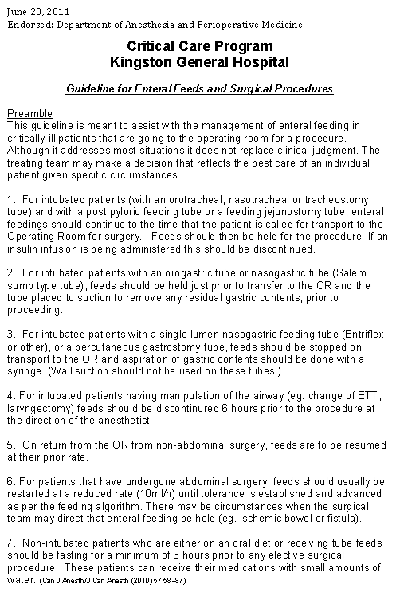
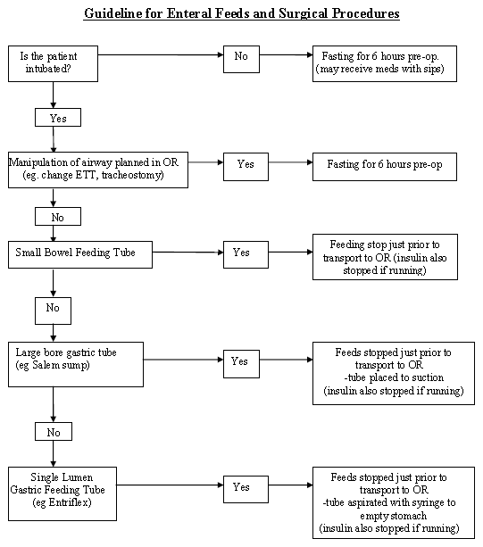
Protocol to Manage Interruptions to EN Due to Non-GI Reasons
Can be downloaded from www.criticalcarenutrition.com

Slide 30
A Quotable Quote
“I don’t have time to go to each patient’s bedside and interrogate the pump and I don’t trust the nursing notes.”
Dietitians throughout the USA
Are there technological solutions that can make the process of monitoring more efficient?

Slide 31
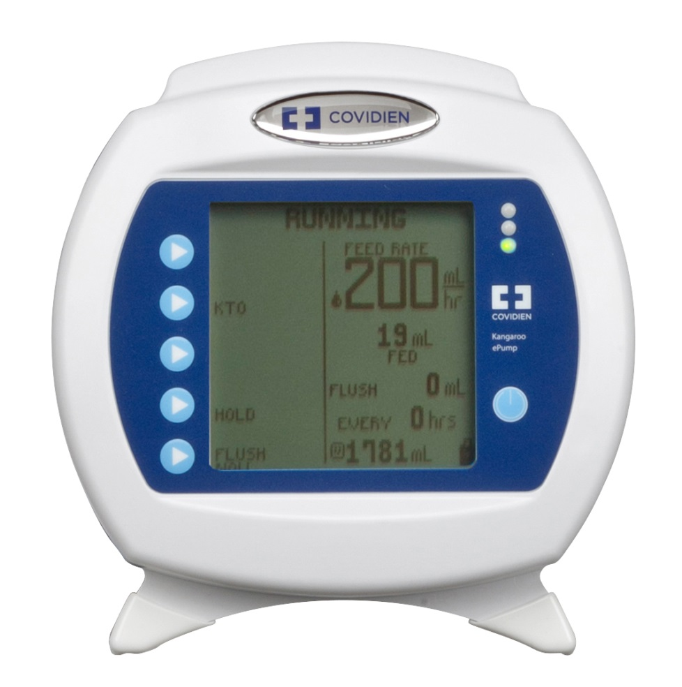
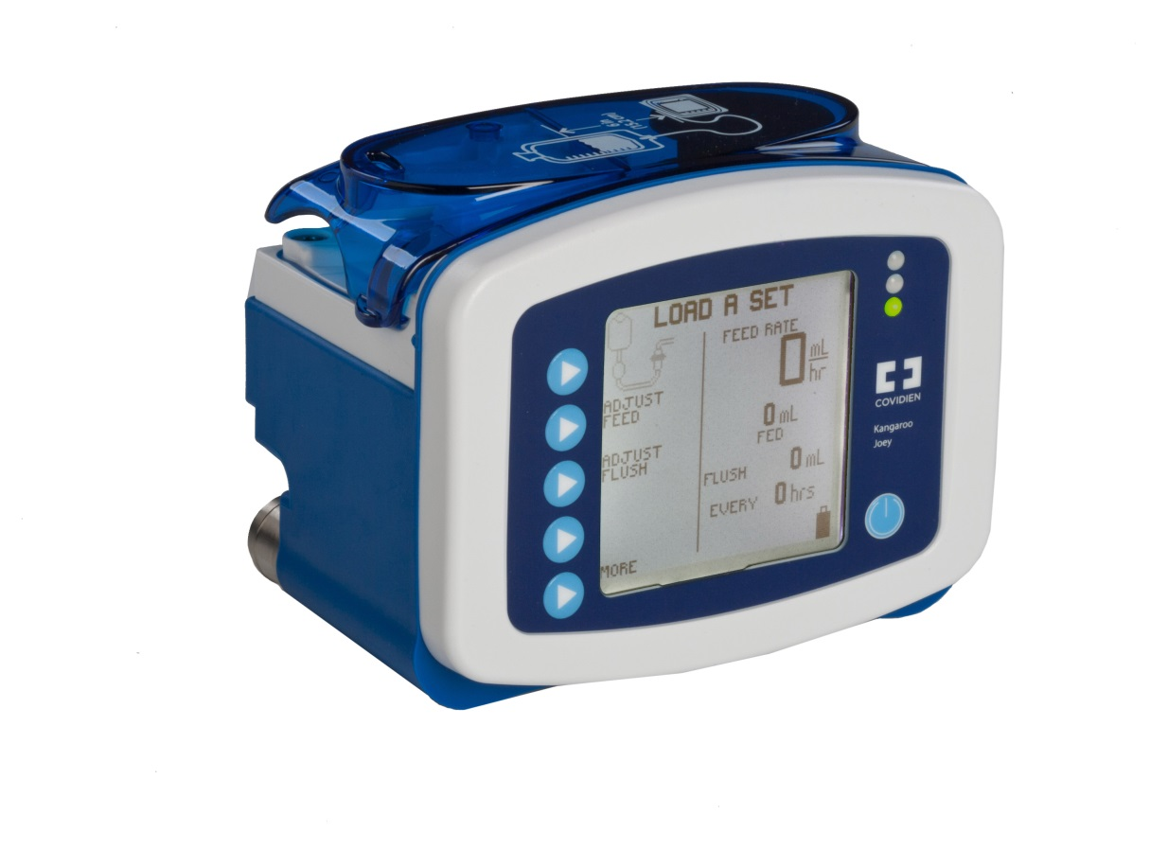
Kangaroo™ Feed/Flush Pumps
Kangaroo™ ePump Kangaroo™ Joey
Designed as an enteral device for institutional care
Designed as an ambulatory enteral device for providing patients with freedom & mobility in ALL care settings

Slide 32
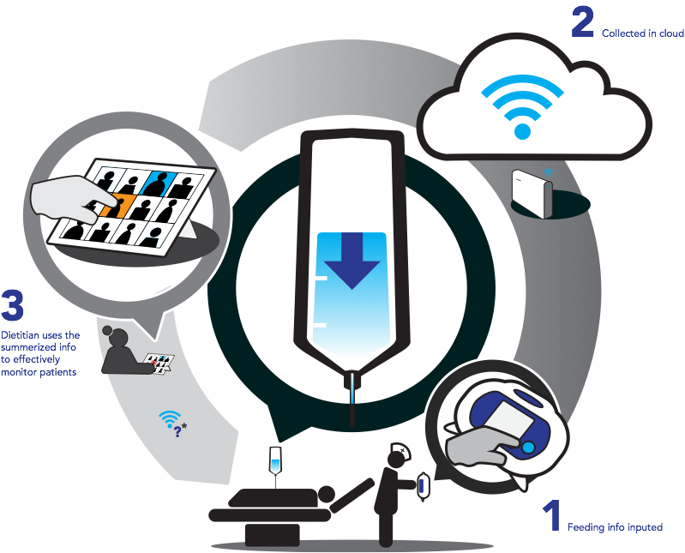
INFORM
Integrated Nutrition Monitoring PlatFORM
Courtesy of Joel Heyland

Slide 33

Pros and Cons of a Cloud-based Registry
Pros
  Don’t have to work with existing EMRs
Cons
  Not connected to existing EMRs

Slide 34

Nutrition Portal
You’d have to enter:
Baseline Patient Information
Age
Hospital and ICU admission
SOFA Score and APACHE II Score (NUTRIC)
Nutritional prescription
Other parts of nutrition assessment
You’d see:
Nutritional prescription
Graphs displaying nutritional risk and nutritional adequacy
Calendar displaying admission and nutritional adequacy (%)
Can be accessed on www.criticalcarenutrition.com

Slide 35
Dysmotility: Contributing factors
Hyper/hypoglycemia
Hypokalemia
Hypophosphotemia
Intra-abdominal hypertension (IAH)
Positive pressure mechanical ventilation
Opioid use
Intravenous catecholamines
Intraoperative intestinal manipulation
Hemorrhage
Fluid overload
Taylor et al, Crit Care Clin 2016

Slide 36
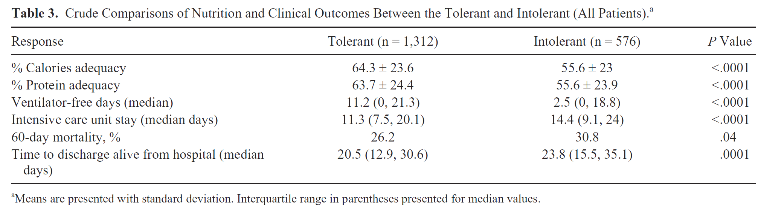
Prevalence, Risk Factors, Clinical Consequences, and Treatment of Enteral Feed Intolerance
During Critical Illness
As defined by local standards (GRV+ interruptions)
Median GRV = 200 mL (range 50-500 mL)
30% Developed intolerance on average on day 3
Gungabissoon 2014 JPEN

Slide 37
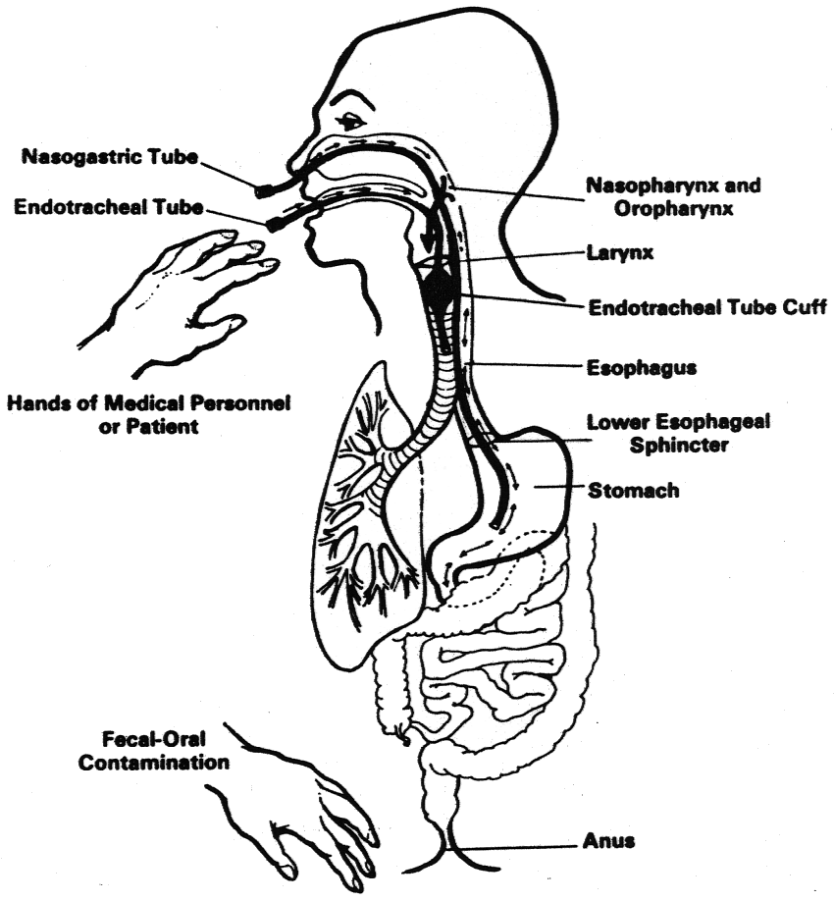
Not just about pushing forward; need to do so safely!
Gastropulmonary Route of Infection

Slide 38
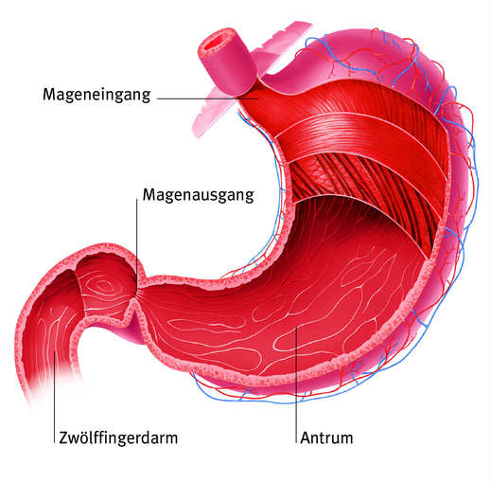


Defining Enteral Feeding Intolerance:
Gastric Residual Volumes
Cardia
GI motility disorders are frequent (up to 80%)
GRV as a surrogate marker to detect GI disorders and avoid risk of aspiration and pneumonia due to regurgitation/vomiting of gastric contents
Lower the GRV, more problems with underfeeding
The higher the GRV, less interruptions
Rate or rapidity of feeding also influences rate of EFI
Pylorus
Duodenum
Antrum
Ukleja A. Nutr Clin Pract. 2010;25:16-25
Lopez-Herce J. Curr Opin Clin Nutr Metab Care. 2009;12:180-5
Notes:
What is the rationale?
The pathophysiology is multifactorial including the severity and etiology of the underlying critical illness, use of narcotic analgesia and other sedatives, decreased blood flow from shock, and use of vasopressors. Gastric dysmotility results in delayed gastric emptying that may place patients at risk of developing complications such as vomiting, aspiration, and ventilator associated pneumonia (VAP).

Slide 39
Systematic Review of Prokinetics in Critically Ill patients receiving EN
Feeding intolerance: GRV > 150 ml, vomiting/abdominal distention leading to interrupted feeding
Prokinetics (erythromycin, metoclopramide)
  Significantly reduced feeding intolerance RR 0.73 p=0.03; 17.3% absolute reduction
  Reduced risk of high gastric residual volumes (RR 0.69, p=0.009)
  Increased success of post-pyloric feeding tube placement (RR 1.6, p=0.004)

Slide 40
Potential Therapeutic Options
Limited Efficacy
+++ side effects
+++Drug-drug interactions
Erythromycin
Metoclopramide
Pipeline Therapeutic Options
Motilin Agonist (GSK)
5HT4 Agonists (Renexion, Takada)
Ghrelin Agonists (Lyric)

Slide 41
Camicinal (GSK962040) – A Novel Motilin Agonist
Scientific Advantages:
  Small, potent, specific motilin agonist
  Long PK and PD action: once daily dosing
  Good bioavailability enterally, good solubility, no food effect
  Eliminated by multiple routes: Should be able to be used in patients with hepatic and renal insufficiencies (TBD)
  No tachyphylaxis to GE effect up to 14 days of administration
  Good safety profile: no significant effect on QT, LFTs to date
GSK962040 has demonstrated safety and effectiveness in it’s ability to enhance gastric emptying in healthy volunteers and patients with diabetic gastroparesis.
? Effect in patients with enteral feeding intolerance.

Slide 42
Nutrition Adequacy Therapeutic Enhancement in the Critically Ill:
A Randomized Double-Blind, Placebo-Controlled Trial of the Motilin Receptor Agonist Camicinal (GSK962040): The NUTRIATE Study
Randomized, placebo-controlled, multicenter trial
Hypothesis: In patients predisposed to feed-intolerance, does pre-emptive camicinal improve the provision of enteral nutrient?
Recruited 84 (of 150) mechanically ventilated patients ‘at risk’ for intolerance:
  Need for vasopressor
  Admission with multi-trauma (ISS > 15)
  Admission with brain injury with (GCS ≤12)
  Received moderate to high opiate (morphine ≥ 2mg/h )
Trial Stopped Prematurely because of lack of treatment effect at Interim Analysis
Deane JPEN 2018

Slide 43
Primary outcome – provision of nutrient
Camicinal: 77% of goal (95% CI 71, 83)
Placebo: 68% of goal (95% CI 58, 78)
Mean difference: 9% (95% CI -5, 23); P=0.21
Incidence of EFI=15% in both groups
Deane JPEN 2018

Slide 44
A Multi-Pronged Approach:
Strategies for Combating Iatrogenic Underfeeeding
*PROBLEMS
Early Intervention
Innovate advanced placement technologies
Admission order sets
*Delayed Feeding
Optimal Delivery
Second generation feeding protocols
Smart Pump Solutions
Integrated Nutrition Monitoring Platform (INFORM)
Therapeutic interventions to prevent and treat ‘dysmotility’
*Inadequate Nutrition
Sustained Nutrition
Provide technology and educational solutions
across the care continuum to promote sustained
nutrition therapy (OPTICS)
*Fragmented
Care
Notes:
Notes to self: General talk track thoughts for our 3 pillars. Delayed Feeding - we know that patients are at increased nutritional risk if they are not fed within 48 hours and early intervention is imperative. Early placement sooner and safely assists with that (ie our IRIS technology). Inadequate Nutrition – there is strong evidence to show patients, especially the critically ill patients, actually receive less than 50% of their nutritional prescription (ie could tie in lack of formula / hydration with our feed / flush pump and pull in your PepUP protocol, INFORM and NUTRIC Score info). Fragmented Care – addresses the transition of patient care after d/c to avoid readmissions related to tube complications, dehydration etc. Tie in OPTICS (Family capacitation strategy) as well as our Kangaroo Wireless Connect Pump for sustained nutrition targeted for home care patients.

Slide 45
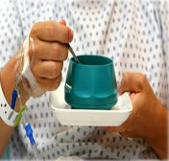
Malnutrition and underfeeding across
the continuum of care
Hospitalized patients:
  • Approximately 31-45% are malnourished
  • Protein/energy depletion and poor patient outcomes
  (Allard JPEN 2016)
ICU patients: increased risk of malnutrition
  • Nutrition adequacy is poor, hyper-catabolic state, poor delivery, intolerance
  • Can result in prolonged stay in ICU, health care costs and higher mortality
(Heyland Clin Nutr 2015)
Post ICU: oral intake post extubation is inadequate
(Peterson JADA 2010)
Post Hospital Syndrome: vulnerable period is 30 days after hospital discharge
(Krumholz NEJM 2013)

Slide 46
Understanding Adherence to Guidelines in the
ICU Development of a Comprehensive Framework
Clinical Practice
Guideline (CPG)
Characteristics
ADHERENCE
Patient Characteristics
Implementation Process
Institutional Factors
Provider Intent
Provider Characteristics
- Profession
Critical care expertise
Educational background
Personality
System
characteristics
Hospital
characteristics
Structure
Processes
Resources
Knowledge
Attitudes
Familiarity
Agreement
Outcome
expectancy
ICU
characteristics
Structure
Processes
Resources
Culture
Awareness
Motivation
Self-efficacy
Cahill N, Heyland DK JPEN Nov 2010

Slide 47

Why Partner with Families of ICU Patients?
Families of critically ill patients
  They are the one constant across the continuum of care
  Provide significant direct care to surviving patients
    Estimated at >$642 Billion per year in costs 2
  Suffer from significant mental health issues including depression1
1 Cameron NEJM 2016;374:1831-1841
2 Chari Health Serv Res 2015;50:871-82

Slide 48

Partnering with Patients and their Families
Partnering with families members of critically ill patients has been shown to:
  decrease patient anxiety, confusion and agitation,
  reduce cardiovascular complications,
  decrease length of stay in the ICU,
  make the patient feel more secure and
  increase patient satisfaction.
Reduces family stress
Overall, it is thought to promote quality and safety in the ICU.
Davidson Crit Care Med 2017

Slide 49
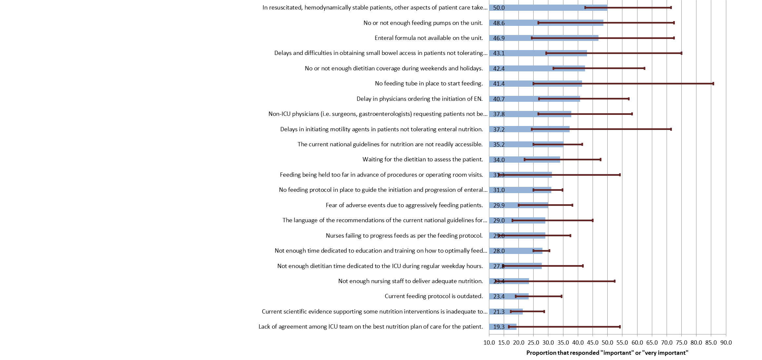
Top Barriers to Enteral Feeding
Cahill J Crit Care 2012 27(6):727-734

Slide 50
A Quotable Quote
“With critical illness, nutrition is often one of the last things
on the minds of the health care team…”
Nurse in OPTICS study
How do we change the culture and make nutrition a higher priority? Airway, Breathing, Circulation, D(Digestion), E(Early EN)

Slide 51

Overall Hypothesis
Educating families about the importance of nutrition and capacitating them to advocate for better nutrition for their loved one in the ICU will result in better nutrition delivery during critical illness and in the recovery phase

Slide 52
OPTimal Nutrition by Informing and Capacitating
Family Members of Best Practises: A multifaceted intervention
Health Care Professional Facing
Family Facing
Educational sessions after ICU admission and on transfer to ward
Educational Booklet and videos
Instructional video
Nutrition Diary tool
Dietitian Support throughout
Nutrition discharge plan
Dietitian led engagement
  Obtaining nutrition history
  Providing educational sessions in ICU and ward
  Responsible for developing care plan and handover to ward staff
  Introduce Nutrition Diary tool
  Follow up in ICU and on ward
  Nutrition discharge plan for home
3-day calorie counts
Training materials (NIBBLES) for other HCP on nutrition and recovery
Orientation to the family facing materials - Posters/info graphics

Slide 53
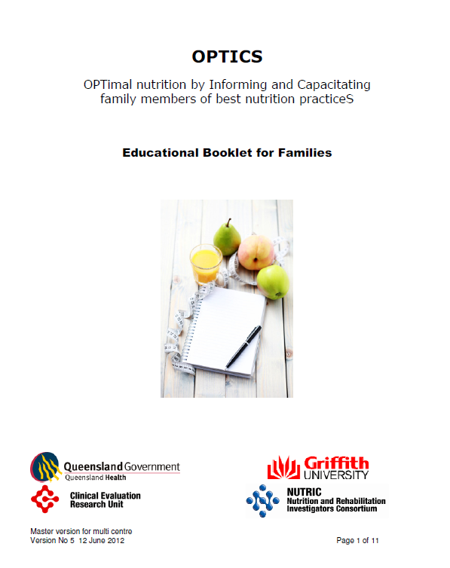

Slide 54
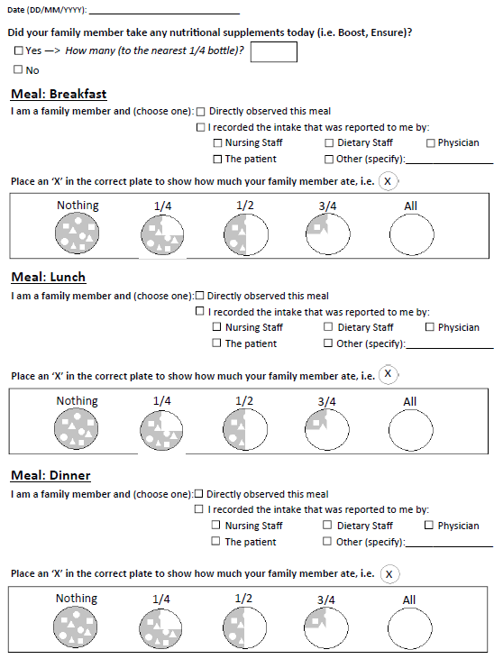
Nutrition Diary
www.criticalcarenutrition.com
IMPACT Nutrition Education Tools – OPTICS Nutrition Diary

Slide 55
Results of a Multi-center Pilot Study
Primary Outcomes
Assess the feasibility of the intervention
  • Recruitment: ability to recruit participants in a timely manner
  • Retention: >80% of patients and families in the study until hospital d/c
Assess the acceptability of the intervention
  • Families: > 80% of families view the intervention as acceptable and that they would be willing to participate again
  • HCPs: >80% of HCPs viewed the intervention as being positive (with respect to family interactions, burden on the family and improvements in patient outcomes)
Lots of feedback helped develop and refine the intervention and outcome measures
Marshall A, Aust Crit Care. 2016

Slide 56

The IMPACT Trial
Improving Partnerships with Family Members of ICU Patients
Overall Study Design
Nutrition Intervention
(OPTICS)
150 Eligible ‘high-risk’ patients and their family members
Process Measures and Short-term outcomes
R
Decision Support
Intervention (My ICU Guide)
Usual Care

Slide 57
A Multi-Pronged Approach:
Strategies for Combating Iatrogenic Underfeeding
*PROBLEMS
Early Intervention
Innovate advanced placement technologies
Admission order sets
*Delayed Feeding
Optimal Delivery
Second generation feeding protocols
Smart Pump Solutions
Integrated Nutrition Monitoring Platform (INFORM)
Therapeutic interventions to prevent and treat ‘dysmotility’
*Inadequate Nutrition
Sustained Nutrition
Provide technology and educational solutions
across the care continuum to promote sustained
nutrition therapy (OPTICS)
*Fragmented
Care
Notes:
Notes to self: General talk track thoughts for our 3 pillars. Delayed Feeding - we know that patients are at increased nutritional risk if they are not fed within 48 hours and early intervention is imperative. Early placement sooner and safely assists with that (ie our IRIS technology). Inadequate Nutrition – there is strong evidence to show patients, especially the critically ill patients, actually receive less than 50% of their nutritional prescription (ie could tie in lack of formula / hydration with our feed / flush pump and pull in your PepUP protocol, INFORM and NUTRIC Score info). Fragmented Care – addresses the transition of patient care after d/c to avoid readmissions related to tube complications, dehydration etc. Tie in OPTICS (Family capacitation strategy) as well as our Kangaroo Wireless Connect Pump for sustained nutrition targeted for home care patients.

Slide 58
Questions?
?

